Slide 1

Database Project: Customer Data for Targeting
An analysis of customer data and database design to enhance marketing campaigns for banking products and services.

Slide 2




Team Members
Gang Wei
Zahid Rahman
Asif Imtiaz
Long Nguyen

Slide 3



Executive Summary
Increasing financial access leads to customer awareness
Engaging marketing campaigns are challenging
Precise targeting strategy is crucial
Banks need to adopt a precise targeting strategy to allocate their resources efficiently and maximize gains from marketing campaigns.
As customers gain access to more financial resources and services, they become increasingly aware of marketing tactics employed by banks and financial institutions.
Creating marketing campaigns that are engaging and rewarding for customers to attract new clients has become a significant challenge for banks.
Effective utilization of customer data and analytics is essential for banks to develop targeted marketing campaigns that resonate with potential customers and optimize resource allocation.

Slide 4





Database Design
Established many-to-one relationships between CUSTOMERS and supporting entities.
Identified CUSTOMERS as the central entity with comprehensive customer information.
Normalized tables to eliminate redundancy and enhance query performance.
Designed supporting entities like MARITAL_STATUS to decode categorical data in CUSTOMERS.
Implemented primary and foreign key constraints for data integrity.

Slide 5
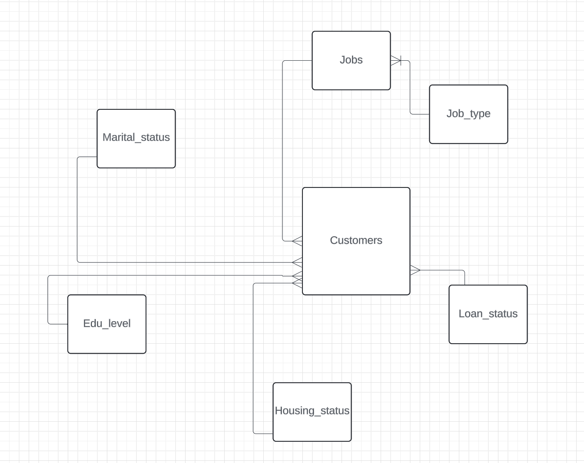
Database Design (Conceptual Design)
Starting with the ERD, our database centers on the CUSTOMERS entity, containing key customer data. Entities like MARITAL_STATUS clarify categories within CUSTOMERS, such as 'divorced', 'single', and 'married'. Relationships are many-to-one, reflecting each customer having one job, though multiple customers may share the same job.
Conceptual Design

Slide 6
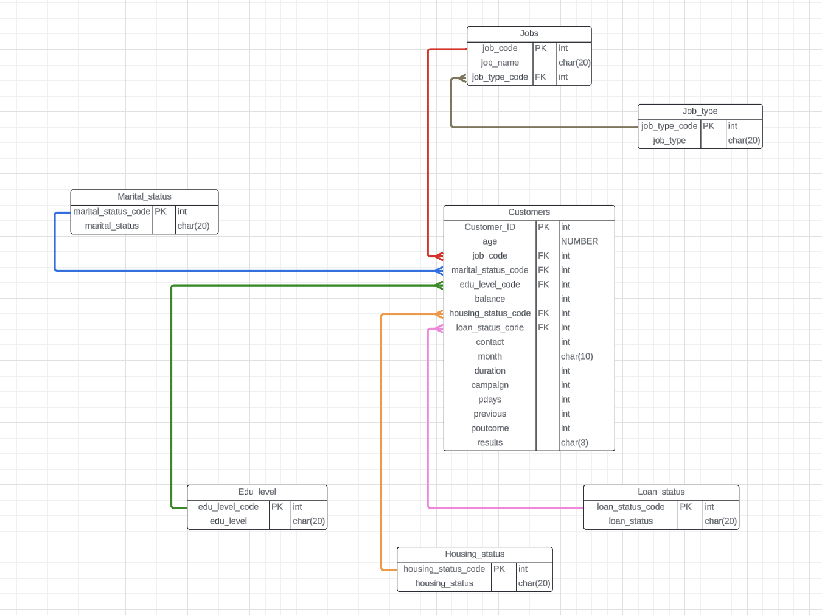
Database Design (Entity-Relationship Diagram)
We initiated the implementation of the CUSTOMERS table using the CREATE TABLE statement in the data definition language (DDL). Employing various data types, including number, integer, and character, we ensured the inclusion of necessary customer data with NOT NULL integrity constraints. Additionally, we established primary key constraints, such as on CUSTOMER_ID, to enhance table structure, data retrieval, and indexing. Furthermore, we maintained consistency across tables by applying similar structures and integrity constraints, while establishing relationships via foreign key constraints to uphold data quality and reliability.
Entity-Relationship Diagram (ERD)

Slide 7
Query Writing
Point Query
Executed a query to retrieve the customer with the maximum balance, requiring a full table scan and resulting in high consistent gets and cost estimates.
Range Query
Queried to select customers contacted in June and July, involving intensive range scans over a large number of rows, leading to significant I/O activities and suboptimal performance.
Scan Query
Performed a full table scan to aggregate the number of customers contacted per month, exhibiting high consistent gets due to the lack of indexing or other optimizations.

Slide 8
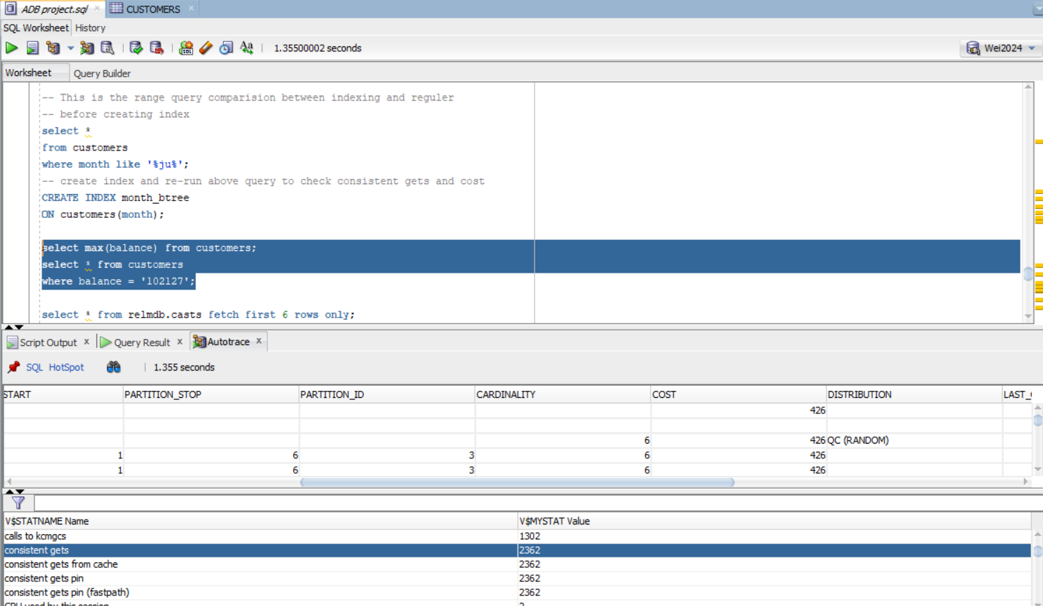
Query Writing (Point Query)
-- Point query (without index)
SELECT max(balance) from customers;
SELECT *
FROM customers
WHERE balance = ‘102127’;
Point Query
This query consists of two parts. The first part calculates the maximum BALANCE value from the CUSTOMERS table, which returns ‘102127’. The second part retrieves all columns for customers whose balance is exactly ‘102127’.
Without an index, both queries will require full table scans, resulting in an estimate cost of 426 and consistent gets of 2362, which are slow and not optimal.

Slide 9
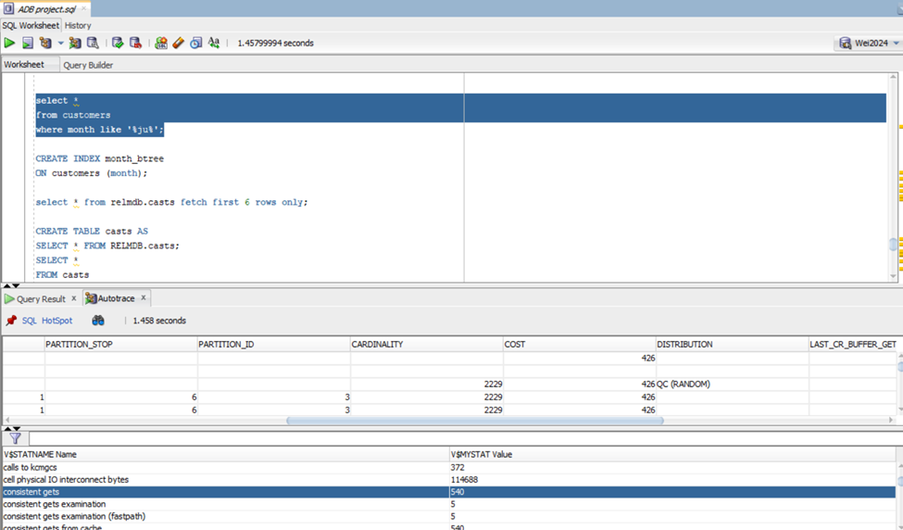
Query Writing (Range Query)
-- RANGE QUERY (WITHOUT INDEX)
SELECT *
FROM CUSTOMERS
WHERE MONTH LIKE ‘%JU%’;
Range Query
The second query we tried to run is a range query, in which we wanted to select all the customers that the bank last contacted in June and July. The idea might be to whom the bank has recently contacted, perhaps to check on their response or incentivize them with a second offer. Since this is an intensive range query over a high number of rows, the query returns cardinality of 2229 and estimate cost of 426. Consistent gets returned is 540, indicating quite a high number of I/O activities during the execution, which can be further improved through indexing.

Slide 10
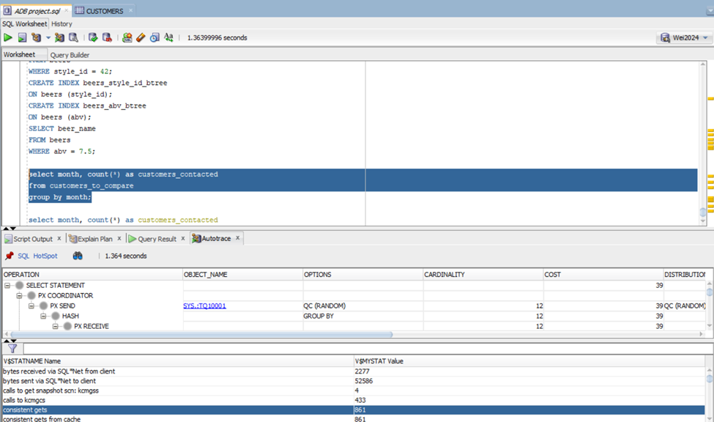
Query Writing (Scan Query)
-- SCAN QUERY (WITHOUT INDEX)
SELECT MONTH, COUNT(*) AS CUSTOMERS_CONTACTED
FROM CUSTOMERS
GROUP BY MONTH;
Scan Query
The last query we ran was a ran query. This query performs a full table scan to aggregate the number of customers contacted per month using COUNT(*). The GROUP BY MONTH clause then groups the customer data by month. This can provide useful information on how productive the sales team from the bank has been throughout the months of each year. The result can also imply the seasonal/monthly fluctuation in the number of customers called. The Autotrace result shows a also high consistent gets of 861 from this query execution.

Slide 11



Performance Tuning
Partitioning
Indexing
Parallelism
We partitioned the large CUSTOMERS table by RANGE on the AGE column into 6 partitions. This allowed queries targeting specific age ranges to scan fewer partitions, reducing I/O and improving performance.
We created B-tree indexes on the MONTH and BALANCE columns of the CUSTOMERS table. Indexing facilitated faster data retrieval by utilizing index structures, significantly reducing consistent gets and execution times for queries involving indexed columns.
We enabled parallel execution by setting the PARALLEL degree of the CUSTOMERS table to 4. This allowed complex queries to be divided and processed simultaneously across multiple CPUs, marginally reducing response times.

Slide 12
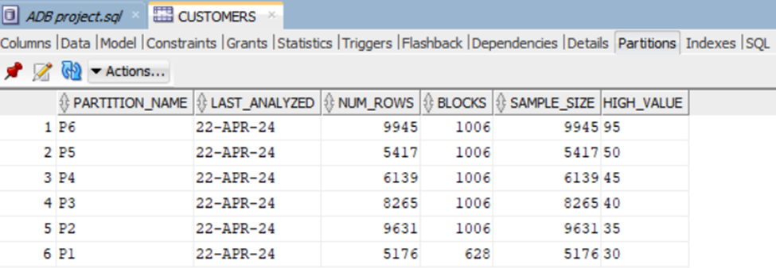
Performance Tuning (Partitioning)
-- Partition the customers table
PARTITION BY RANGE (age)
(
PARTITION p1 VALUES less than (30),
PARTITION p2 VALUES less than (35),
PARTITION p3 VALUES less than (40),
PARTITION p4 VALUES less than (45),
PARTITION p5 VALUES less than (50),
PARTITION p6 VALUES less than (95)
);
Partitioning
Partitioning involves dividing large tables or indexes into smaller segments called partitions that can be stored in different file groups. Partitioning uses specific criteria such as range, list, or hash. This method can enhance query performance by enabling parallelism and allowing queries to target specific partitions, reducing the amount of data scanned for operations. Additionally, partitioning can enhance availability and scalability by enabling more efficient data distribution and management across multiple storage devices or servers.
By implementing partitioning, we aim to improve the performance and manageability of the database.

Slide 13
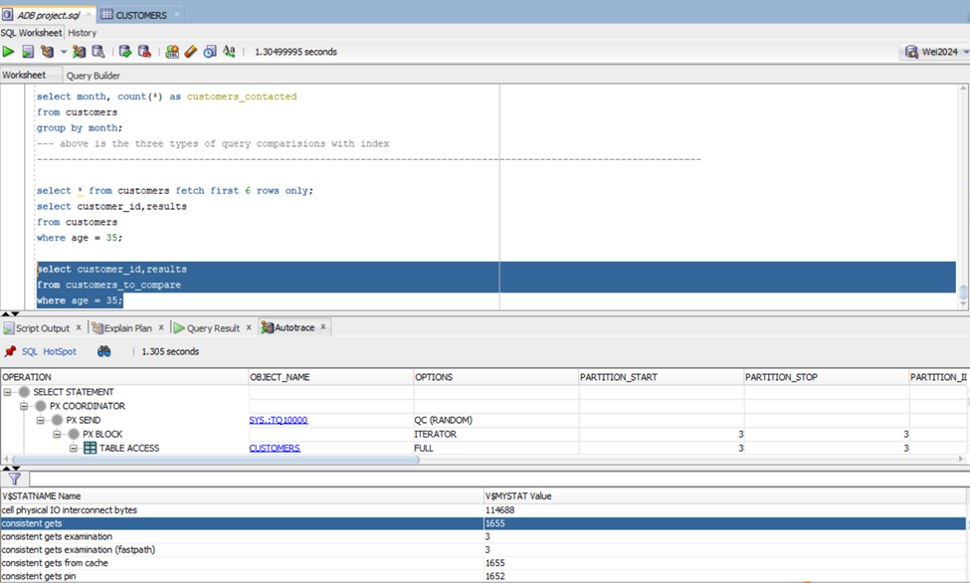
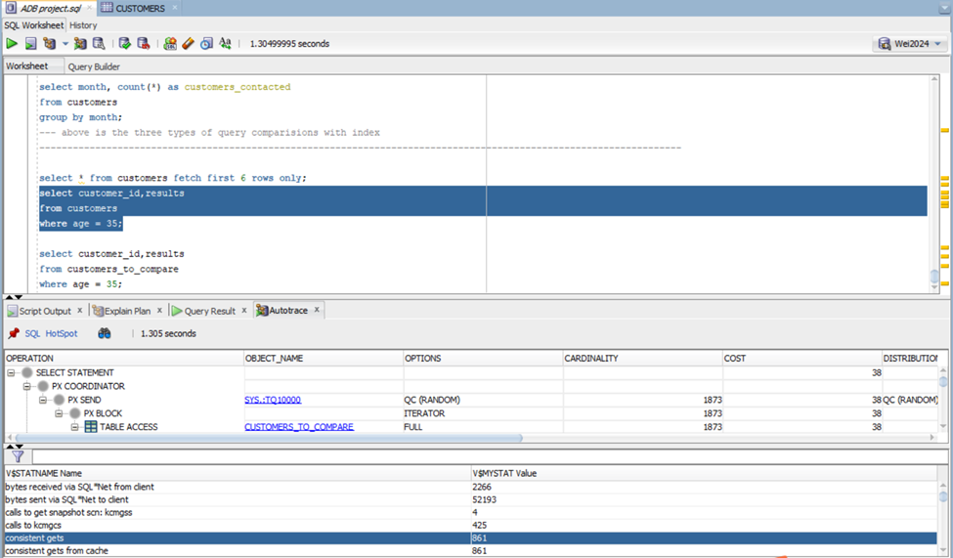
Performance Tuning (Partitioning)
-- Query to test database performance with partitioning
SELECT customer_id, results
FROM customers
WHERE age = 35;
Partitioning
The PARTITION BY RANGE (AGE) below was included when we deployed the CREATE TABLE CUSTOMERS code. This technique will divide the CUSTOMERS entity into 6 smaller partitions specified by their age. We chose range partitioning over list or hash because it is the best fit for the sequential AGE values, as well as the fact that it allows new data entries to be automatically placed into the age-based partition with ease. In order to evaluate the improvement in performance, we ran the query left before and after partitioning.

Slide 14
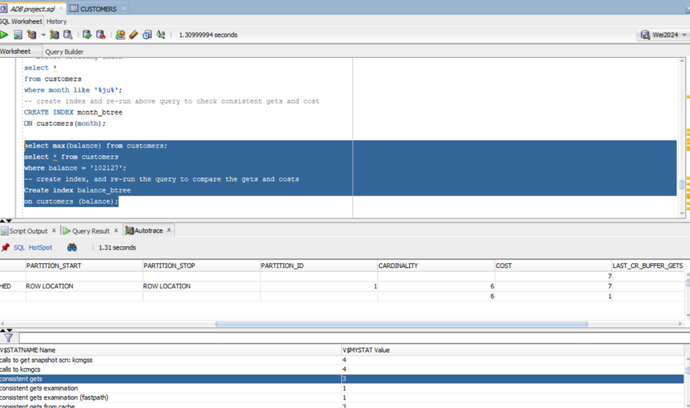
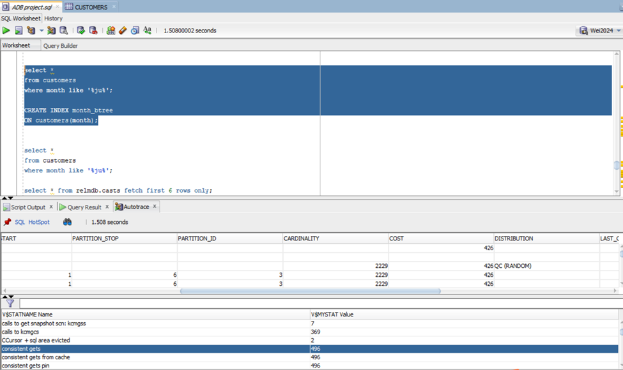
Performance Tuning (Indexing)
-- Create indexes on the customer entity
CREATE INDEX month_btree
ON customers(month);
Indexing
The second performance tuning technique we applied is indexing. Indexing improves database performance by facilitating quick data retrieval and efficient query processing. When we set indexes on specific columns in a database table, we essentially create a data structure that allows the database management system to locate rows quickly using the indexed column values.
Point Query with Indexed Column
Range Query with Indexed Column

Slide 15
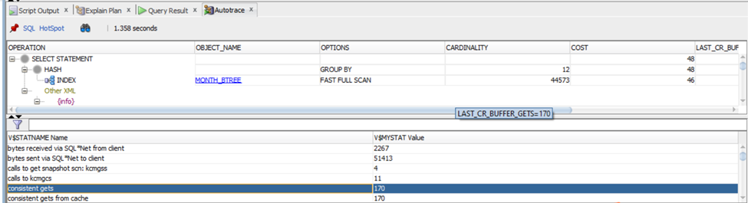
Performance Tuning (Indexing)
-- Create indexes on the customer entity
CREATE INDEX month_btree
ON customers(month);
Indexing
After indexing our database, the performance improves significantly. The point query sees a drastic change in consistent gets as the number goes from 2362 to just 3, as well as the estimate cost. This is because the query uses the indexed column (BALANCE) in its WHERE clause, which helps locate the row much faster than having to execute a full table scan. The range query also returns a lower consistent gets, going down from 540 to 496. The improvement is not as noticeable as seen from the point or scan query, which reports a consistent gets of only 170 compared to 861 without index. As expected, we can see the improvement in performance across all query types, further showing that indexing is effective and necessary for us to achieve an optimal database system.
Scan Query with Indexed Column

Slide 16
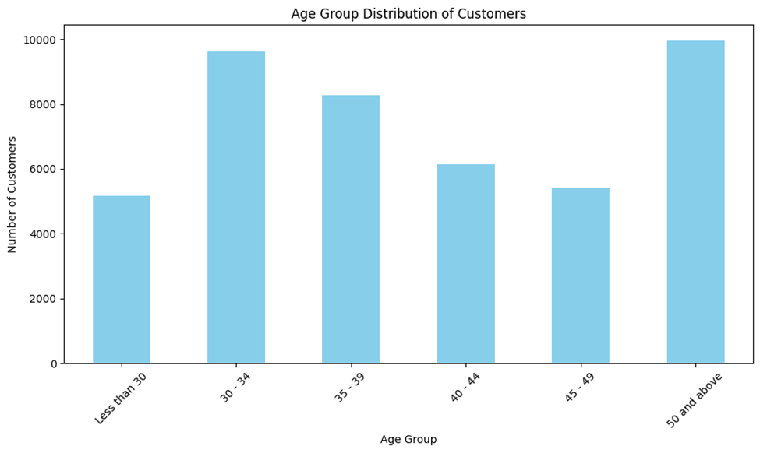
Data Visualization
To generate graphical visualizations like histograms directly within the tool, we imported the data into Python and constructed a figure using the matplotlib package. In the graph above, we used the Customers data and the age column to examine the distribution of the bank’s customers using age groups. Apparently, most of their clients are between 30 and 49 years old, which is understandable because people within this range tend to have more assets for savings and investments. Also, interestingly, between 30 – 49, the number of customers decreases as age increases. Furthermore, people who are 50 and above account for a significant percentage of their customer base.

Slide 17
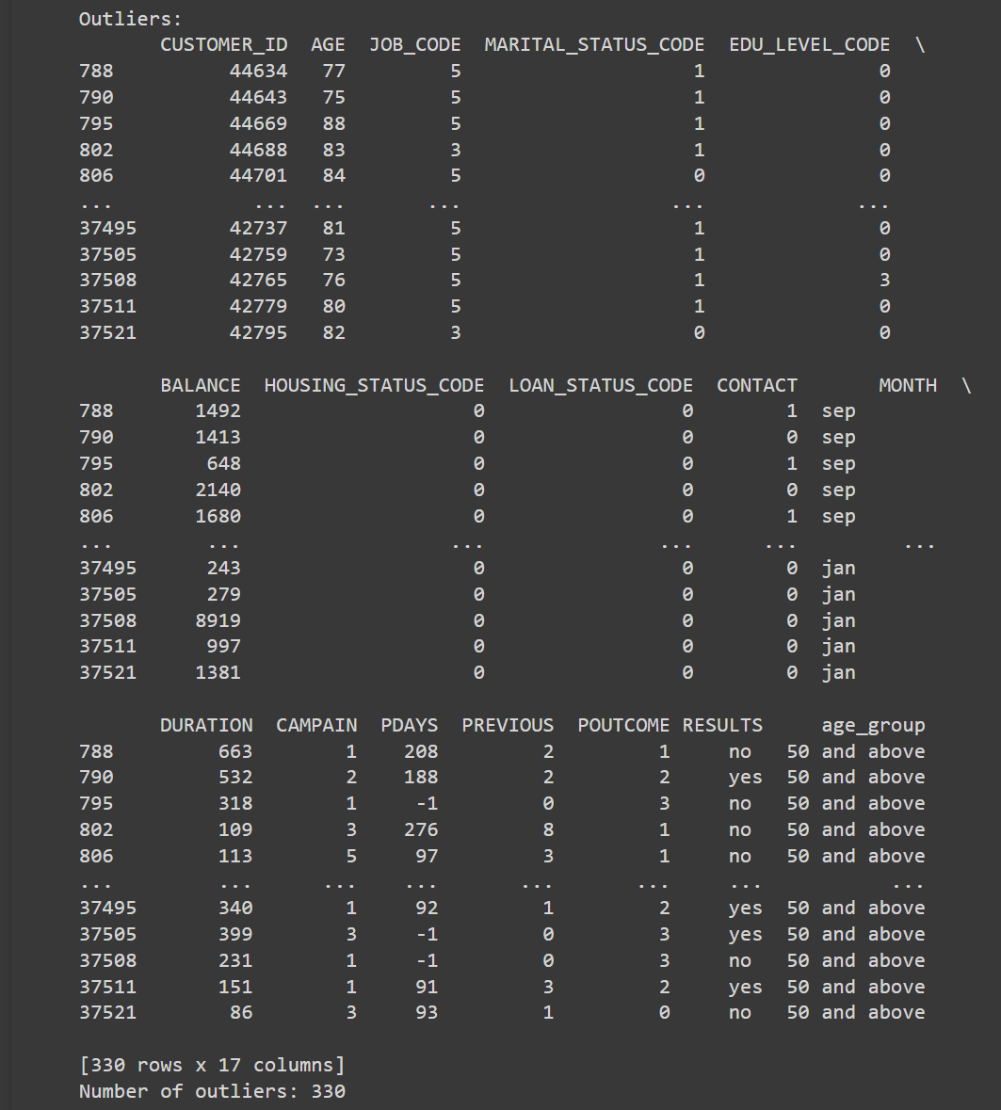
Outlier lookup of Data Mining
In statistics, an outlier is a data point that differs significantly from other observations. Basically, any observations that fall outside of three standard deviations from the mean are considered an outlier. Having too many outliers in a data set potentially leads to quality issues, creates unusual patterns, and results in misleading insights in analysis. Therefore, we used python to calculate mean and standard deviation of the customer age, then identify outliers by comparing the data with the 3 standard deviation thresholds. A total number of 330 outliers are detected

Slide 18


